Slide 1
Balancing Ball
A Unity Project
Prepared By:
Dhaval Pankhaniya
Aniket Kariya
Guided By:
J.D. Dhanesha

Slide 2
A quick recap

Slide 3

Before Starting

Slide 4
Before Starting
You might be knowing most of persons displayed in picture.
India is an emerging superpower, supplies a large amount of brain resource and Indians are excellent in every field, spread across the world.
But still, there are some fields in which India needs to get developed.
One of that field is Game Development.

Slide 5
Before Starting

Slide 6
Goal
So, You may have already got it that why we took game development. India has some active major game industries; such as Lakshya Digital. But the problem is that it only works on outsourced projects.
And, nobody likes to invest in Game Development in India, because developing games requires too much time and resources, in addition to high expenses and the main reason, the risk of success of games.

Slide 7
Goal
Most of the major games, having fabulous graphics and excellent gameplay comes with rating of M and A which obviously means that it is not appropriate for children and even for teenagers. In addition they are costly as well.
We wanted to make a kind of game with the rating of E which means that it can be played by anyone, and do not contain violative, hateful or abusive content, and don’t waste too much time of user, so user don’t get addicted to it.

Slide 8
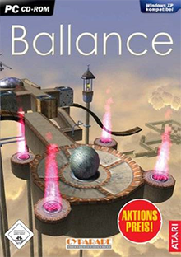
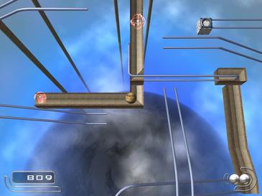
About The Game
This game is inspired from a Windows-platform based game “ballance”, and we will be re-creating this obsolete game as our project with a new interface, and enhancing the gameplay.

Slide 9
Functionalities
Playable with Arrow Keys, WASD and Joystick.
If Ball falls over the stage, then 1 life lost / game is over
Automatic camera trace to the ball and user can control camera with the help of mouse/trackpad.
Difficulty as pass through each level.
Different Kind of balls equipped with a special ability to play; such as wooden ball, paper ball and metal ball.
Will be available on Windows Platform.

Slide 10
At The End
Our game may not help to increase the game development growth in India. But if the game becomes successful, it might inspire new game developers.

Slide 11
Queries from last presentation
How the complexity of level increases ?
How and in which form the data will be stored ?
How it Is different from other games available in market like this ?
Covered in upcoming slides

Slide 12
Game Design Document

Slide 13
Game Design Document
Section 01 – Game Overview
Game Title: | Balancing Ball
Game Genre: | 3D / Puzzle
Game perspective: | Third Person
Game Mode: | Single Player
Target Audience: | Age 08-20
Goal: | To reach at the destination

Slide 14
Game Design Document
Section 02 – Game Play
2.1 Objective(s) & Game Logic:
Navigate through Terrain
Get life to try again from checkpoint once you lost.
Reach at the destination in Time.
Try not to fall off ground
Avoid dangerous colliders
Save Level Progress at Checkpoint (at Level Scope)
Save Levels to resume playing from last level (at Game scope)

Slide 15
Game Design Document
Section 02 – Game Play
2.2 In-game Help and info:
Info and help is provided as a pop-up card at the first time, to visualize how to play the game, how to navigate scene. Furthermore, provided when necessary, when introducing new things.

Slide 16
Game Design Document
Section 03 – Game Elements
3.1 Environment:
The location of the Game is a closed-fantasy terrain. There are different types of objects in environment to make the game more interesting, such as colliders, Blocked ways, Bridges, Caves etc...

Slide 17
Game Design Document
Section 03 – Game Elements
3.2 Characters:
3.2.1 Playable Character
You have to reach at destination using a Player, which is a “Ball”.
3.2.2 Non-Playable Objects:
Objects to provide difficulties: Bridge, Colliders, Pipes, Stairs, grids etc. No AI character in this version.

Slide 18
Game Design Document
Section 04 – Game Play I/O controls & GUI Interface:
4.1 Game Play I/O controls:
Keys to move player:
Arrow Keys, WASD Keys, Joystick
Special Keys:
Escape Key: Pause, Enter: Select Key
Mouse:
To move around Player
To navigate through menu

Slide 19
Game Design Document
Section 05 – Visual and Audio Features:
5.1 Visual Features:
Hud:
Bottom-right: Life
Top-left: Score
Top-right: Time
5.2 Audio Features:
Different Collision Sound Effects
Environment/Default Music
Game Start, Life Lost, Game Over & Level Complete Sounds
Most of Sound Effects will be Composed by Us / No copyrighted sound is used.

Slide 20
Game Design Document
Section 06: Creativity & Special Enhancements in Game Concepts :
Third person camera angle
Dynamic shadows & Ligthing
Player orbit camera control
Animations
(How it is Different From Other Games)

Slide 21
Technical Design Document

Slide 22
Technical Design Document
Section 01 – List of features captured from GDD
Game Overview
Game Play
Game Elements
Game Play I/O controls & GUI Interface
Visual & Audio Features
Creativity & Special Enhancements

Slide 23
Technical Design Document
Section 02 – Choice of Game Engine
The game engine that we chosen is Unity. Unity uses C# as scripting language and possesses awesome features such as:
Animation
AI
Audio System
Virtual Game Environment
Physics Support
Prefabs
Realtime as well as Baked lighting and Animation Support

Slide 24
Technical Design Document
Section 02 – Choice of Game Engine
The reason that we chose Unity because after trying three other different game engines including Cry Engine, Unreal Engine and GameMaker Studios, we found Unity the most flexible. Furthermore, unlike Cry Engine and Unreal Engine, Unity also provides a free version for personal use along with the paid ones. Also, Unity provides vast variety of plugins and assets for all of its users.

Slide 25
Technical Design Document
Section 03 – Schedule
Task | Week 0-2 | Week 2-4 | Week 4-6 | Week 6-8 | Week 8-10 | Week 10-12 | Week 12-14 | Week 14-17
Documentation
Modelling
Texturing
Animation
Implementation
Sound Effects
Testing
27 Jun 2018
01 Jan 2018

Slide 26
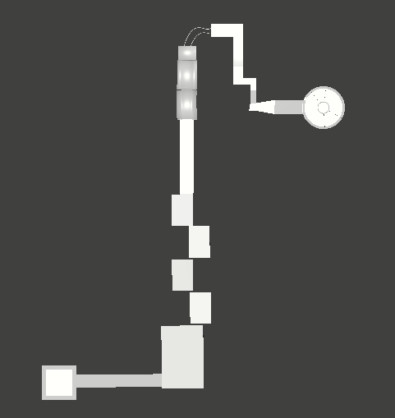
Technical Design Document
Section 04 – High-level Diagrams to illustrate Game Design
4.1 Layout Diagram

Slide 27

Technical Design Document
Section 04 – High-level Diagrams to illustrate Game Design
4.1 Layout Diagram

Slide 28
Technical Design Document
Section 04 – High-level Diagrams to illustrate Game Design
4.2 Technology Diagram:
The technology diagram indicates the technology that is going to be used for different aspects of the game and is displayed in following figure.
Technologies used
Blender
Unity
Photohop
LMMS

Slide 29
Technical Design Document
Section 05 – Art Tools
5.1 Blender
5.1.1 Version: 2.78c / 2.79
5.1.2 About Blender
Open-Source 3D content creation tool
Features include: Character Modelling, Hard-surface Modelling, Animation, Rigging, Rendering, Compositing, Weight Painting, Sculpting etc..
5.1.3 What it will be used for:
For creating 3D models, level design, texturing objects etc..

Slide 30
Technical Design Document
Section 05 – Art Tools
5.2 Photoshop
5.2.1 Version: CS6
5.2.2 About Photoshop
Allows user to manipulate and create images using a variety of tools: Brush tool, Fill tool, Clone stamping, 3D object rotation
Supports transparent images, custom size canvas
This is beneficial to us as sprites needs to be on transparent background and of fixed pixels in size. We can easily create sprites with the use of Photoshop
It is also useful for creating texture maps for objects.
5.2.3 What it will be used for:
For creating sprites, textures and editing them.

Slide 31
Technical Design Document
Section 05 – Art Tools
5.3 L.M.M.S
5.3.1 Version: 1.1.3
5.3.2 About LMMS
Linux Multimedia Studio is a software for creating Music without musical instruments on your computer.
It supports all controls that a standard musical instrument has. It has chords of every available device today, making it possible to generate any kind of rhythm.
It also has a equalizer, separate volume controls, and a frequency manipulator. It supports both mono and stereo output with wide variety of export format support.
5.3.3 What it will be used for:
Creating music requires lots of time and patience for creating a quality music. so, we will be only making short sound effects using it.

Slide 32
Technical Design Document
Section 06 – Scene Management
Scene Management is necessary for the efficient rendering and loading of complex scenes as well as smooth gameplay.
We provide scene management by modular level approach and prefabs that also leads to better memory utilization.

Slide 33
Technical Design Document
Section 07 – Collision detection, Physics & Interaction
7.1 Collision Detection:
his is where there will need to be detection of the intersection of two or more objects within the game
Player should not be able to move through objects – rigid bodies.
Collision detection will be needed for when:
Player and obstacle collide (I.e. Ground itself, bridges, checkpoints etc.)
Opening Treasure chests
Wind Force

Slide 34
Technical Design Document
Section 07 – Collision detection, Physics & Interaction
7.2 Physics:
This is the component what makes game to follow the real-life principles and allows to add things such as Rigid Body to add mass, friction and gravity scale to the player.
Physics is needed for pushing objects as well as smashing objects. As well as moving the player.
Unity comes with a preinstalled physics support which makes it easy for us to implement physics with minimum efforts.

Slide 35
Technical Design Document
Section 07 – Collision detection, Physics & Interaction
7.3 Interaction:
This is how the player interact with the game world.
Interactions with object:
Picking up coins, power-ups and lives.
Collecting treasure
Section 8 – Artificial Intelligence
No initial artificial intelligence support.

Slide 36
Technical Design Document
Section 09 – Delivery Platform & Hardware / Software Requirements
9.1 Delivery Platform
Windows PCs
9.2 Minimum System Requirements:
RAM: | 1GB
Processor: | Intel Core 2 Duo
Graphics card: | Intel HD 520
Operating System: | Windows XP
DirectX | DirectX 10

Slide 37
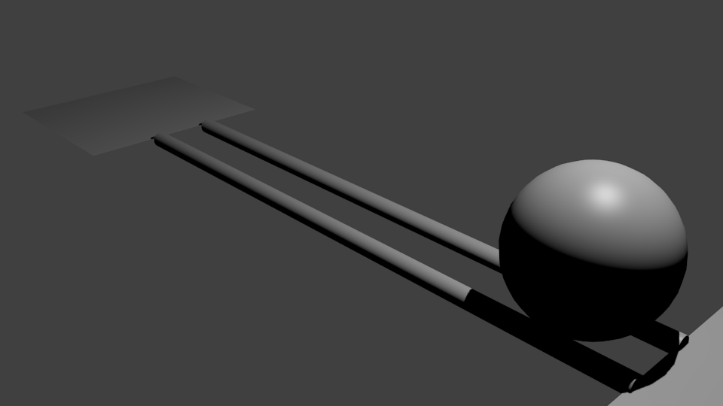
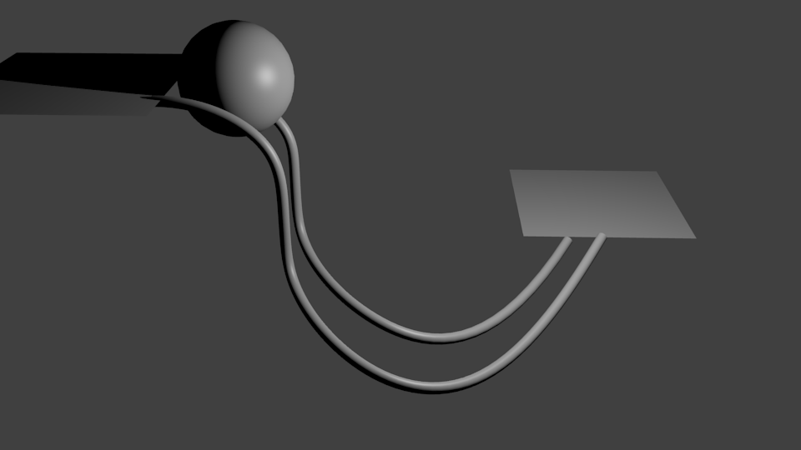
Queries:
How the Complexity of level increases ?

Slide 38
Queries:
How and in which form the data will be stored ?
Game Data is stored in .dat file format
Stored at %UserProfile%/AppData/Local/Packages/PackageName/ (On windows, By default for all data)
The last scene(level), points and other information will be stored in form of binary data In our case.

Slide 39
How much we have done till now
(Demo)

Slide 40
Thank You

